Slide 1
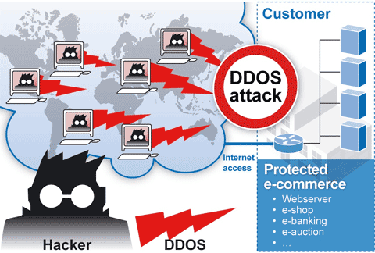
Denial-of-Service Attacks (chapter 7)
Ian Welch
NWEN 405 - 2017
Slides based upon Stallings & Brown 3rd ed

Slide 2
The NIST Computer Security Incident Handling Guide defines a DoS attack as:
“An action that prevents or impairs the authorized use of networks, systems, or applications by exhausting resources such as central processing units (CPU), memory, bandwidth, and disk space.”
Notes:
2
Denial of service is a form of attack on the availability of some service. In the context
of computer and communications security, the focus is generally on network
services that are attacked over their network connection. We distinguish this form
of attack on availability from other attacks, such as the classic acts of god, that
cause damage or destruction of IT infrastructure and consequent loss of service.
The NIST Computer Security Incident Handling Guide [SCAR08] defines
denial-of-service (DoS) attack as follows:
A denial of service (DoS) is an action that prevents or impairs the authorized
use of networks, systems, or applications by exhausting resources such as central
processing units (CPU), memory, bandwidth, and disk space.

Slide 3
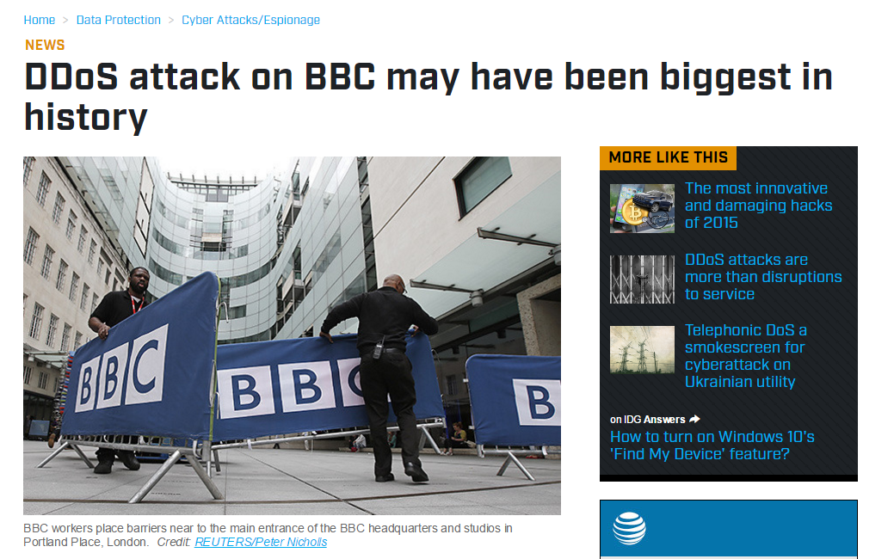
New Years day 2016 for multiple hours – peaked at 602Gbps twice the maximum ever seen before.
May have used a tool “DDoS as a service” - BangStresser. Might have simply been a marketing campaign for the tool itself.
Notes:
3

Slide 4
A form of attack on the availability of some service.
Three main categories of resources that could be attacked.
Network bandwidth
System resources
Application resources
Relates to the capacity of the network links connecting a server to the Internet
Aims to overload or crash the network handling software
Typically involves a number of valid requests, each of which consumes significant resources, thus limiting the ability of the server to respond to requests from other users
For most organizations this is their connection to their Internet Service Provider (ISP)
Notes:
4
From this definition, you can see that there are several categories of resources
that could be attacked:
• Network bandwidth
• System resources
• Application resources
Network bandwidth relates to the capacity of the network links connecting a server
to the wider Internet. For most organizations, this is their connection to their Internet
service provider (ISP), as shown in the example network in Figure 7.1. Usually this
connection will have a lower capacity than the links within and between ISP routers.
This means it is possible for more traffic to arrive at the ISP’s routers over these
higher-capacity links than can be carried over the link to the organization. In this
circumstance, the router must discard some packets, delivering only as many as can
be handled by the link. In normal network operation such high loads might occur
to a popular server experiencing traffic from a large number of legitimate users. A
random portion of these users will experience a degraded or nonexistent service as
a consequence. This is expected behavior for an overloaded TCP/IP network link.
In a DoS attack, the vast majority of traffic directed at the target server is malicious,
generated either directly or indirectly by the attacker. This traffic overwhelms
any legitimate traffic, effectively denying legitimate users access to the server. Some
recent high volume attacks have even been directed at the ISP network supporting
the target organization, aiming to disrupt its connections to other networks. A number
of recent DDoS attacks are listed in [AROR11], with comments on their growth
in volume and impact.
A DoS attack targeting system resources typically aims to overload or crash its
network handling software. Rather than consuming bandwidth with large volumes
of traffic, specific types of packets are sent that consume the limited resources available
on the system. These include temporary buffers used to hold arriving packets,
tables of open connections, and similar memory data structures. The SYN spoofing
attack, which we discuss next, is of this type. It targets the table of TCP connections
on the server.
Another form of system resource attack uses packets whose structure triggers
a bug in the system’s network handling software, causing it to crash. This means the
system can no longer communicate over the network until this software is reloaded,
generally by rebooting the target system. This is known as a poison packet . The
classic ping of death and teardrop attacks, directed at older Windows 9x systems,
were of this form. These targeted bugs in the Windows network code that handled
ICMP (Internet Control Message Protocol) echo request packets and packet fragmentation,
respectively.
An attack on a specific application, such as a Web server, typically involves a
number of valid requests, each of which consumes significant resources. This then
limits the ability of the server to respond to requests from other users. For example,
a Web server might include the ability to make database queries. If a large,
costly query can be constructed, then an attacker could generate a large number of
these that severely load the server. This limits its ability to respond to valid requests
from other users. This type of attack is known as a cyberslam . [KAND05] discusses
attacks of this kind, and suggests some possible countermeasures. Another
alternative is to construct a request that triggers a bug in the server program, causing
it to crash. This means the server is no longer able to respond to requests until
it is restarted.
DoS attacks may also be characterized by how many systems are used to direct
traffic at the target system. Originally only one, or a small number of source systems
directly under the attacker’s control, was used. This is all that is required to send the
packets needed for any attack targeting a bug in a server’s network handling code or
some application. Attacks requiring high traffic volumes are more commonly sent
from multiple systems at the same time, using distributed or amplified forms of DoS
attacks. We discuss these later in this chapter.

Slide 5
Notes:
5
Figure 7.1
Example Network to Illustrate DoS Attacks

Slide 6
Classic DoS Attacks #1
Refer to handout showing example network.
Flooding ping command (ICMP)
Aim of this attack is to overwhelm the capacity of the network connection to the target organization
Traffic can be handled by higher capacity links on the path, but packets are discarded as link capacity decreases
Source of the attack is clearly identified unless a spoofed address is used
Network performance is noticeably affected
When reaches victim’s router
Bad for the attacker
Notes:
6
The simplest classical DoS attack is a flooding attack on an organization. The aim
of this attack is to overwhelm the capacity of the network connection to the target
organization. If the attacker has access to a system with a higher-capacity network
connection, then this system can likely generate a higher volume of traffic than the
lower-capacity target connection can handle. For example, in the network shown
in Figure 7.1 , the attacker might use the large company’s Web server to target the
medium-sized company with a lower-capacity network connection. The attack might
be as simple as using a flooding ping command directed at the Web server in the
target company. This traffic can be handled by the higher-capacity links on the path
between them, until the final router in the Internet cloud is reached. At this point
some packets must be discarded, with the remainder consuming most of the capacity
on the link to the medium-sized company. Other valid traffic will have little chance
of surviving discard as the router responds to the resulting congestion on this link.
In this classic ping flood attack, the source of the attack is clearly identified
since its address is used as the source address in the ICMP echo request packets. This
has two disadvantages from the attacker’s perspective. First, the source of the attack
is explicitly identified, increasing the chance that the attacker can be identified and
legal action taken in response. Second, the targeted system will attempt to respond to
the packets being sent. In the case of any ICMP echo request packets received by the
server, it would respond to each with an ICMP echo response packet directed back
to the sender. This effectively reflects the attack back at the source system. Since
the source system has a higher network bandwidth, it is more likely to survive this
reflected attack. However, its network performance will be noticeably affected, again
increasing the chances of the attack being detected and action taken in response. For
both of these reasons the attacker would like to hide the identity of the source system.
This means that any such attack packets need to use a falsified, or spoofed, address.

Slide 7
Source Address Spoofing
Use forged source addresses
Usually via the raw socket interface on operating systems
- Makes attacking systems harder to identify
Attacker generates large volumes of packets that have the target system as the destination address
Congestion would result in the router connected to the final, lower capacity link
Requires network engineers to specifically query flow information from their routers
Backscatter traffic
-Advertise routes to unused IP addresses to monitor attack traffic
Notes:
7
A common characteristic of packets used in many types of DoS attacks is the use
of forged source addresses. This is known as source address spoofing. Given sufficiently
privileged access to the network handling code on a computer system, it
is easy to create packets with a forged source address (and indeed any other attribute
that is desired). This type of access is usually via the raw socket interface on
many operating systems. This interface was provided for custom network testing
and research into network protocols. It is not needed for normal network operation.
However, for reasons of historical compatibility and inertia, this interface has been
maintained in many current operating systems. Having this standard interface available
greatly eases the task of any attacker trying to generate packets with forged
attributes. Otherwise an attacker would most likely need to install a custom device
driver on the source system to obtain this level of access to the network, which is
much more error prone and dependent on operating system version.
Given raw access to the network interface, the attacker now generates large
volumes of packets. These would all have the target system as the destination
address but would use randomly selected, usually different, source addresses for
each packet. Consider the flooding ping example from the previous section. These
custom ICMP echo request packets would flow over the same path from the source
toward the target system. The same congestion would result in the router connected
to the final, lower capacity link. However, the ICMP echo response packets, generated
in response to those packets reaching the target system, would no longer
be reflected back to the source system. Rather they would be scattered across the
Internet to all the various forged source addresses. Some of these addresses might
correspond to real systems. These might respond with some form of error packet,
since they were not expecting to see the response packet received. This only adds to
the flood of traffic directed at the target system. Some of the addresses may not be
used or may not reachable. For these, ICMP destination unreachable packets might
be sent back. Or these packets might simply be discarded. Any response packets
returned only add to the flood of traffic directed at the target system.
Also, the use of packets with forged source addresses means the attacking
system is much harder to identify. The attack packets seem to have originated at
addresses scattered across the Internet. Hence, just inspecting each packet’s header
is not sufficient to identify its source. Rather the flow of packets of some specific
form through the routers along the path from the source to the target system must
be identified. This requires the cooperation of the network engineers managing all
these routers and is a much harder task than simply reading off the source address.
It is not a task that can be automatically requested by the packet recipients. Rather
it usually requires the network engineers to specifically query flow information
from their routers. This is a manual process that takes time and effort to organize.
It is worth considering why such easy forgery of source addresses is allowed on
the Internet. It dates back to the development of TCP/IP, which occurred in a generally
cooperative, trusting environment. TCP/IP simply does not include the ability,
by default, to ensure that the source address in a packet really does correspond with
that of the originating system. It is possible to impose filtering on routers to ensure
this (or at least that source network address is valid). However, this filtering needs
to be imposed as close to the originating system as possible, where the knowledge
of valid source addresses is as accurate as possible. In general, this should occur at
the point where an organization’s network connects to the wider Internet, at the
borders of the ISP’s providing this connection. Despite this being a long-standing
security recommendation to combat problems such as DoS attacks, many ISPs
do not implement such filtering. As a consequence, attacks using spoofed-source
packets continue to occur frequently.
There is a useful side effect of this scattering of response packets to some
origi nal flow of spoofed-source packets. Security researchers, such as those with the
Honeynet Project, have taken blocks of unused IP addresses, advertised routes to
them, and then collected details of any packets sent to these addresses. Since no real
systems use these addresses, no legitimate packets should be directed to them. Any
packets received might simply be corrupted. It is much more likely, though, that
they are the direct or indirect result of network attacks. The ICMP echo response
packets generated in response to a ping flood using randomly spoofed source
addresses is a good example. This is known as backscatter traffic . Monitoring the
type of packets gives valuable information on the type and scale of attacks being
used, as described by [MOOR06], for example. This information is being used to
develop responses to the attacks being seen.

Slide 8
Classic Attack # 2
SYN spoofing
Common DoS attack
Attacks the ability of a server to respond to future connection requests by overflowing the tables used to manage them
Thus legitimate users are denied access to the server
Hence an attack on system resources, specifically the network handling code in the operating system.
PROVIDES MULTIPLYING EFFECT FOR ATTACKER
Notes:
8
Along with the basic flooding attack, the other common classic DoS attack is the
SYN spoofing attack. This attacks the ability of a network server to respond to TCP
connection requests by overflowing the tables used to manage such connections.
This means future connection requests from legitimate users fail, denying them
access to the server. It is thus an attack on system resources, specifically the network
handling code in the operating system.

Slide 9
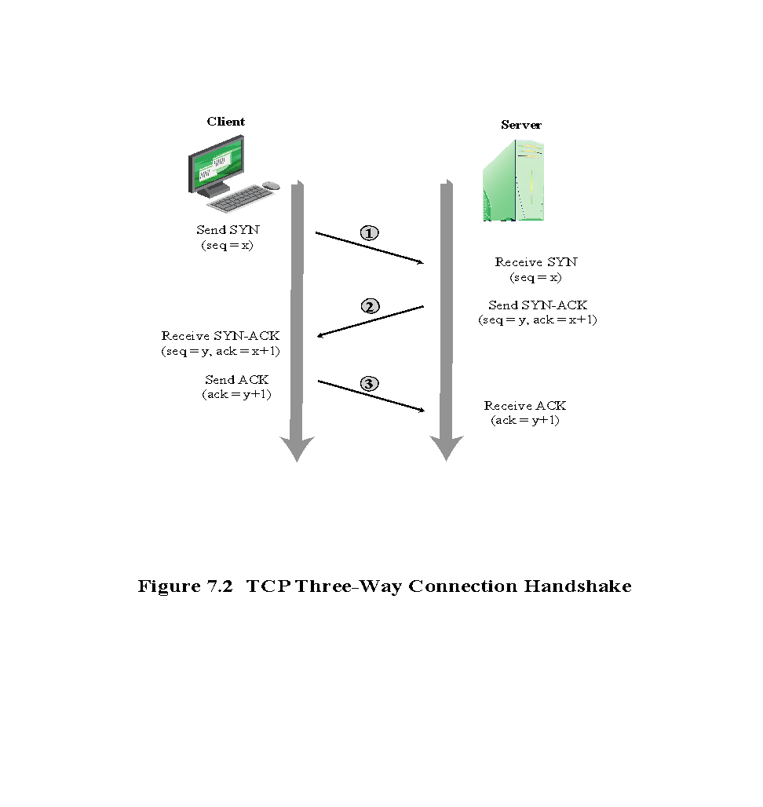
Notes:
9
To understand the operation of these attacks, we need to review the three-way
handshake that TCP uses to establish a connection. This is illustrated in Figure 7.2 .
The client system initiates the request for a TCP connection by sending a SYN packet
to the server. This identifies the client’s address and port number and supplies an
initial sequence number. It may also include a request for other TCP options. The
server records all the details about this request in a table of known TCP connections.
It then responds to the client with a SYN-ACK packet. This includes a sequence
number for the server and increments the client’s sequence number to confirm receipt
of the SYN packet. Once the client receives this, it sends an ACK packet to the server
with an incremented server sequence number and marks the connection as established.
Likewise, when the server receives this ACK packet, it also marks the connection
as established. Either party may then proceed with data transfer. In practice, this
ideal exchange sometimes fails. These packets are transported using IP, which is an
unreliable, though best-effort, network protocol. Any of the packets might be lost in
transit, as a result of congestion, for example. Hence both the client and server keep
track of which packets they have sent and, if no response is received in a reasonable
time, will resend those packets. As a result, TCP is a reliable transport protocol, and
any applications using it need not concern themselves with problems of lost or reordered
packets. This does, however, impose an overhead on the systems in managing
this reliable transfer of packets.

Slide 10
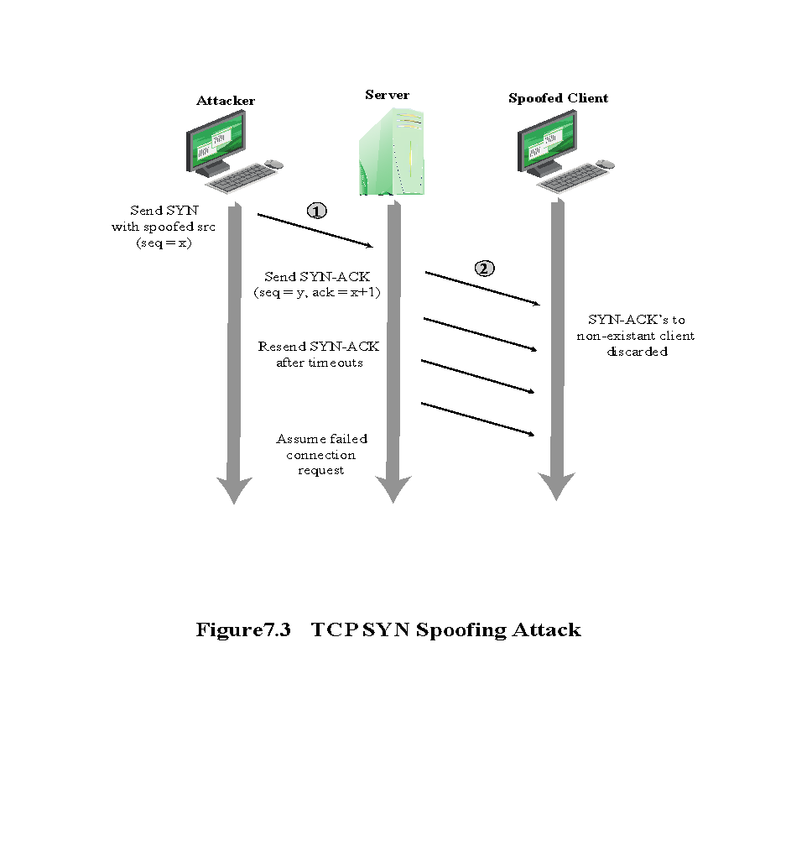
Notes:
10
A SYN spoofing attack exploits this behavior on the targeted server system.
The attacker generates a number of SYN connection request packets with forged
source addresses. For each of these the server records the details of the TCP connection
request and sends the SYN-ACK packet to the claimed source address,
as shown in Figure 7.3 . If there is a valid system at this address, it will respond
with a RST (reset) packet to cancel this unknown connection request. When the
server receives this packet, it cancels the connection request and removes the saved
information. However, if the source system is too busy, or there is no system at the
forged address, then no reply will return. In these cases the server will resend the
SYN-ACK packet a number of times before finally assuming the connection request
has failed and deleting the information saved concerning it. In this period between
when the original SYN packet is received and when the server assumes the request
has failed, the server is using an entry in its table of known TCP connections. This
table is typically sized on the assumption that most connection requests quickly
succeed and that a reasonable number of requests may be handled simultaneously.
However, in a SYN spoofing attack, the attacker directs a very large number of
forged connection requests at the targeted server. These rapidly fill the table of
known TCP connections on the server. Once this table is full, any future requests,
including legitimate requests from other users, are rejected. The table entries will
time out and be removed, which in normal network usage corrects temporary
overflow problems. However, if the attacker keeps a sufficient volume of forged
requests flowing, this table will be constantly full and the server will be effectively
cut off from the Internet, unable to respond to most legitimate connection requests.
In order to increase the usage of the known TCP connections table, the
attacker ideally wishes to use addresses that will not respond to the SYN-ACK with
a RST. This can be done by overloading the host that owns the chosen spoofed
source address, or by simply using a wide range of random addresses. In this case,
the attacker relies on the fact that there are many unused addresses on the Internet.
Consequently, a reasonable proportion of randomly generated addresses will not
correspond to a real host.
There is a significant difference in the volume of network traffic between a
SYN spoof attack and the basic flooding attack we discussed. The actual volume of
SYN traffic can be comparatively low, nowhere near the maximum capacity of the
link to the server. It simply has to be high enough to keep the known TCP connections
table filled. Unlike the flooding attack, this means the attacker does not need
access to a high-volume network connection. In the network shown in Figure 7.1 ,
the medium-sized organization, or even a broadband home user, could successfully
attack the large company server using a SYN spoofing attack.
A flood of packets from a single server or a SYN spoofing attack originating
on a single system were probably the two most common early forms of DoS attacks.
In the case of a flooding attack this was a significant limitation, and attacks evolved
to use multiple systems to increase their effectiveness. We next examine in more
detail some of the variants of a flooding attack. These can be launched either from a
single or multiple systems, using a range of mechanisms, which we explore.

Slide 11
Flooding Attacks
Ping flood using ICMP echo request packets
Traditionally network administrators allow such packets into their networks because ping is a useful network diagnostic tool
Classified based on network protocol used
Intent is either to overload the network capacity on some link to a server
or overload the server’s ability to handle and respond to traffic
Virtually any type of network packet can be used
Uses UDP packets directed to some port number on the target system
ICMP flood
Sends TCP packets to the target system
Total volume of packets is the aim of the attack rather than the system code
UDP flood
TCP SYN flood
Notes:
11
Flooding attacks take a variety of forms, based on which network protocol is being
used to implement the attack. In all cases the intent is generally to overload the
network capacity on some link to a server. The attack may alternatively aim to
overload the server’s ability to handle and respond to this traffic. These attacks flood
the network link to the server with a torrent of malicious packets competing with, and
usually overwhelming, valid traffic flowing to the server. In response to the congestion
this causes in some routers on the path to the targeted server, many packets will be
dropped. Valid traffic has a low probability of surviving discard caused by this flood
and hence of accessing the server. This results in the server’s ability to respond to
network connection requests being either severely degraded or failing entirely.
Virtually any type of network packet can be used in a flooding attack. It simply
needs to be of a type that is permitted to flow over the links toward the targeted system,
so that it can consume all available capacity on some link to the target server. Indeed,
the larger the packet, the more effective is the attack. Common flooding attacks use
any of the ICMP, UDP, or TCP SYN packet types. It is even possible to flood with
some other IP packet type. However, as these are less common and their usage more
targeted, it is easier to filter for them and hence hinder or block such attacks.
The ping flood using ICMP echo request packets we discuss in Section 7.1 is a classic
example of an ICMP flooding attack. This type of ICMP packet was chosen since
traditionally network administrators allowed such packets into their networks, as
ping is a useful network diagnostic tool. More recently, many organizations have
restricted the ability of these packets to pass through their firewalls. In response,
attackers have started using other ICMP packet types. Since some of these should
be handled to allow the correct operation of TCP/IP, they are much more likely to
be allowed through an organization’s firewall. Filtering some of these critical ICMP
packet types would degrade or break normal TCP/IP network behavior. ICMP
destination unreachable and time exceeded packets are examples of such critical
packet types.
An attacker can generate large volumes of one of these packet types. Because
these packets include part of some notional erroneous packet that supposedly
caused the error being reported, they can be made comparatively large, increasing
their effectiveness in flooding the link.
An alternative to using ICMP packets is to use UDP packets directed to some port
number, and hence potential service, on the target system. A common choice was a
packet directed at the diagnostic echo service, commonly enabled on many server
systems by default. If the server had this service running, it would respond with a
UDP packet back to the claimed source containing the original packet data contents.
If the service is not running, then the packet is discarded, and possibly an
ICMP destination unreachable packet is returned to the sender. By then the attack
has already achieved its goal of occupying capacity on the link to the server. Just
about any UDP port number can be used for this end. Any packets generated in
response only serve to increase the load on the server and its network links.
Spoofed source addresses are normally used if the attack is generated using
a single source system, for the same reasons as with ICMP attacks. If multiple systems
are used for the attack, often the real addresses of the compromised, zombie,
systems are used. When multiple systems are used, the consequences of both the
reflected flow of packets and the ability to identify the attacker are reduced.
Another alternative is to send TCP packets to the target system. Most likely these
would be normal TCP connection requests, with either real or spoofed source
addresses. They would have an effect similar to the SYN spoofing attack we’ve
described. In this case, though, it is the total volume of packets that is the aim of the
attack rather than the system code. This is the difference between a SYN spoofing
attack and a SYN flooding attack.
This attack could also use TCP data packets, which would be rejected by the
server as not belonging to any known connection. But again, by this time the attack
has already succeeded in flooding the links to the server.
All of these flooding attack variants are limited in the total volume of traffic
that can be generated if just a single system is used to launch the attack. The use
of a single system also means the attacker is easier to trace. For these reasons, a
variety of more sophisticated attacks, involving multiple attacking systems, have
been developed. By using multiple systems, the attacker can significantly scale up
the volume of traffic that can be generated. Each of these systems need not be particularly
powerful or on a high-capacity link. But what they don’t have individually,
they more than compensate for in large numbers. Also, by directing the attack
through intermediaries, the attacker is further distanced from the target and significantly
harder to locate and identify. Indirect attack types that utilize multiple
systems include
• Distributed denial-of-service attacks
• Reflector attacks
• Amplifier attacks
We consider each of these in turn.

Slide 12
Distributed Denial of Service DDoS Attacks
Use of multiple systems to generate attacks
Attacker uses a flaw in operating system or in a common application to gain access and installs their program on it (zombie)
Large collections of such systems under the control of one attacker’s control can be created, forming a botnet
Notes:
12
Recognizing the limitations of flooding attacks generated by a single system, one
of the earlier significant developments in DoS attack tools was the use of multiple
systems to generate attacks. These systems were typically compromised user workstations
or PCs. The attacker used some well-known flaw in the operating system or
in some common application to gain access to these systems and to install his or her
own programs on it. Such systems are known as zombies. Once suitable backdoor
programs were installed on these systems, they were entirely under the attacker’s
control. Large collections of such systems under the control of one attacker can be
created, collectively forming a botnet, as we discuss in Chapter 6 . Such networks of
compromised systems are a favorite tool of attacker, and can be used for a variety
of purposes, including distributed denial-of-service (DDoS) attacks. In the example
network shown in Figure 7.1 , some of the broadband user systems may be compromised
and used as zombies to attack any of the company or other links shown.
Many other DDoS tools have been developed since. Instead of using dedicated
handler programs, many now use an IRC or similar instant messaging server
program to manage communications with the agents. Many of these more recent
tools also use cryptographic mechanisms to authenticate the agents to the handlers,
in order to hinder analysis of command traffic.
The best defense against being an unwitting participant in a DDoS attack is to
prevent your systems from being compromised. This requires good system security
practices and keeping the operating systems and applications on such systems current
and patched.
For the target of a DDoS attack, the response is the same as for any flooding
attack, but with greater volume and complexity. We discuss appropriate defenses
and responses in Sections 7.5 and 7.6 .

Slide 13
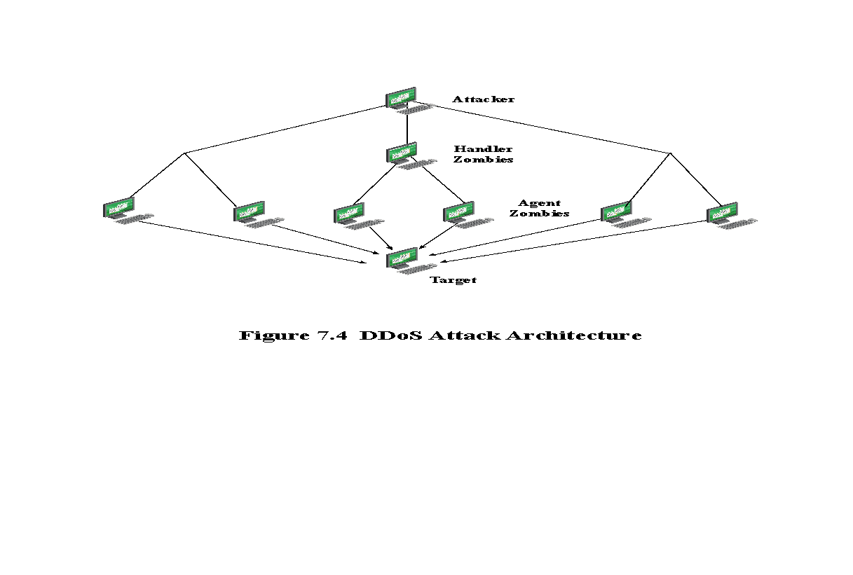
Notes:
13
While the attacker could command each zombie individually, more generally
a control hierarchy is used. A small number of systems act as handlers controlling a
much larger number of agent systems, as shown in Figure 7.4 . There are a number of
advantages to this arrangement. The attacker can send a single command to a handler,
which then automatically forwards it to all the agents under its control. Automated
infection tools can also be used to scan for and compromise suitable zombie systems,
as we discuss in Chapter 6 . Once the agent software is uploaded to a newly compromised
system, it can contact one or more handlers to automatically notify them of its
availability. By this means, the attacker can automatically grow suitable botnets.
One of the earliest and best-known DDoS tools is Tribe Flood Network
(TFN), written by the hacker known as Mixter. The original variant from the 1990s
exploited Sun Solaris systems. It was later rewritten as Tribe Flood Network 2000
(TFN2K) and could run on UNIX, Solaris, and Windows NT systems. TFN and
TFN2K use a version of the two-layer command hierarchy shown in Figure 7.4. The
agent was a Trojan program that was copied to and run on compromised, zombie
systems. It was capable of implementing ICMP flood, SYN flood, UDP flood, and
ICMP amplification forms of DoS attacks. TFN did not spoof source addresses in
the attack packets. Rather it relied on a large number of compromised systems,
and the layered command structure, to obscure the path back to the attacker. The
agent also implemented some other rootkit functions as we describe in Chapter 6.
The handler was simply a command-line program run on some compromised systems.
The attacker accessed these systems using any suitable mechanism giving
shell access, and then ran the handler program with the desired options. Each handler
could control a large number of agent systems, identified using a supplied list.
Communications between the handler and its agents was encrypted and could be
intermixed with a number of decoy packets. This hindered attempts to monitor and
analyze the control traffic. Both these communications and the attacks themselves
could be sent via randomized TCP, UDP, and ICMP packets. This tool demonstrates
the typical capabilities of a DDoS attack system.
Many other DDoS tools have been developed since. Instead of using dedicated
handler programs, many now use an IRC or similar instant messaging server
program, or web-based HTTP servers, to manage communications with the agents.
Many of these more recent tools also use cryptographic mechanisms to authenticate
the agents to the handlers, in order to hinder analysis of command traffic.
The best defense against being an unwitting participant in a DDoS attack is to
prevent your systems from being compromised. This requires good system security
practices and keeping the operating systems and applications on such systems current
and patched.
For the target of a DDoS attack, the response is the same as for any flooding
attack, but with greater volume and complexity. We discuss appropriate defenses
and responses in Sections 7.5 and 7.6.

Slide 14
Hypertext Transfer Protocol (HTTP) Based Attacks
HTTP flood
Slowloris
Attack that bombards Web servers with HTTP requests
Consumes considerable resources
Spidering
- Bots starting from a given HTTP link and following all links on the provided Web site in a recursive way
Attempts to monopolize by sending HTTP requests that never complete
Eventually consumes Web server’s connection capacity
Utilizes legitimate HTTP traffic
Existing intrusion detection and prevention solutions that rely on signatures to detect attacks will generally not recognize Slowloris
Notes:
We consider two different approaches to exploiting the Hypertext Transfer Protocol
(HTTP) to deny service.
An HTTP flood refers to an attack that bombards Web servers
with HTTP requests. Typically, this is a DDoS attack, with HTTP requests coming
from many different bots. The requests can be designed to consume considerable
resources. For example, an HTTP request to download a large file from the target
causes the Web server to read the file from hard disk, store it in memory, convert it
into a packet stream, and then transmit the packets. This process consumes memory,
processing, and transmission resources.
A variant of this attack is known as a recursive HTTP flood. In this case, the
bots start from a given HTTP link and then follows all links on the provided Web
site in a recursive way. This is also called spidering.
An intriguing and unusual form of HTTP-based attack is Slowloris
[SOUR12], [DAMO12]. Slowloris exploits the common server technique of using
multiple threads to support multiple requests to the same server application. It
attempts to monopolize all of the available request handling threads on the Web
server by sending HTTP requests that never complete. Since each request consumes
a thread, the Slowloris attack eventually consumes all of the Web server’s connection
capacity, effectively denying access to legitimate users.
The HTTP protocol specification (RFC2616) states that a blank line must be
used to indicate the end of the request headers and the beginning of the payload,
if any. Once the entire request is received, the Web server may then respond. The
Slowloris attack operates by establishing multiple connections to the Web server.
On each connection, it sends an incomplete request that does not include the terminating
newline sequence. The attacker sends additional header lines periodically to
keep the connection alive, but never sends the terminating newline sequence. The
Web server keeps the connection open, expecting more information to complete
the request. As the attack continues, the volume of long-standing Slowloris connections
increases, eventually consuming all available Web server connections, thus
rendering the Web server unavailable to respond to legitimate requests.
Slowloris is different from typical denials of service in that Slowloris traffic
utilizes legitimate HTTP traffic, and does not rely on using special “bad” HTTP
requests that exploit bugs in specific HTTP servers. Because of this, existing intrusion
detection and intrusion prevention solutions that rely on signatures to detect
attacks will generally not recognize Slowloris. This means that Slowloris is capable
of being effective even when standard enterprise-grade intrusion detection and
intrusion prevention systems are in place.
There are a number of countermeasures that can be taken against Slowloris
type attacks, including limiting the rate of incoming connections from a particular
host; varying the timeout on connections as a function of the number of connections;
and delayed binding. Delayed binding is performed by load balancing software. In
essence, the load balancer performs an HTTP request header completeness check,
which means that the HTTP request will not be sent to the appropriate Web server
until the final two carriage return and line feeds are sent by the HTTP client. This is
the key bit of information. Basically, delayed binding ensures that your Web server
or proxy will never see any of the incomplete requests being sent out by Slowloris.
14

Slide 15
Reflection Attacks
Attacker sends packets to a known service on the intermediary with a spoofed source address of the actual target system
When intermediary responds, the response is sent to the target
“Reflects” the attack off the intermediary (reflector)
Goal is to generate enough volumes of packets to flood the link to the target system without alerting the intermediary
The basic defense against these attacks is blocking spoofed-source packets
Notes:
15
In contrast to DDoS attacks, where the intermediaries are compromised systems
running the attacker’s programs, reflector and amplifier attacks use network systems
functioning normally. The attacker sends a network packet with a spoofed source
address to a service running on some network server. The server responds to this
packet, sending it to the spoofed source address that belongs to the actual attack
target. If the attacker sends a number of requests to a number of servers, all with the
same spoofed source address, the resulting flood of responses can overwhelm the
target’s network link. The fact that normal server systems are being used as intermediaries,
and that their handling of the packets is entirely conventional, means
these attacks can be easier to deploy and harder to trace back to the actual attacker.
There are two basic variants of this type of attack: the simple reflection attack and
the amplification attack.
The reflection attack is a direct implementation of this type of attack. The attacker
sends packets to a known service on the intermediary with a spoofed source address
of the actual target system. When the intermediary responds, the response is sent to
the target. Effectively this reflects the attack off the intermediary, which is termed
the reflector, and is why this is called a reflection attack.
Ideally the attacker would like to use a service that created a larger response
packet than the original request. This allows the attacker to convert a lower volume
stream of packets from the originating system into a higher volume of packet data
from the intermediary directed at the target. Common UDP services are often used
for this purpose. Originally the echo service was a favored choice, although it does
not create a larger response packet. However, any generally accessible UDP service
could be used for this type of attack. The chargen, DNS, SNMP, or ISAKMP6
services have all been exploited in this manner, in part because they can be made to
generate larger response packets directed at the target.
The intermediary systems are often chosen to be high-capacity network servers
or routers with very good network connections. This means they can generate
high volumes of traffic if necessary, and if not, the attack traffic can be obscured in
the normal high volumes of traffic flowing through them. If the attacker spreads the
attack over a number of intermediaries in a cyclic manner, then the attack traffic
flow may well not be easily distinguished from the other traffic flowing from the
system. This, combined with the use of spoofed source addresses, greatly increases
the difficulty of any attempt to trace the packet flows back to the attacker’s system.
Another variant of reflection attack uses TCP SYN packets and exploits the
normal three-way handshake used to establish a TCP connection. The attacker sends
a number of SYN packets with spoofed source addresses to the chosen intermediaries.
In turn the intermediaries respond with a SYN-ACK packet to the spoofed
source address, which is actually the target system. The attacker uses this attack
with a number of intermediaries. The aim is to generate high enough volumes of
packets to flood the link to the target system. The target system will respond with a
RST packet for any that get through, but by then the attack has already succeeded
in overwhelming the target’s network link.
This attack variant is a flooding attack that differs from the SYN spoofing
attack we discussed earlier in this chapter. The goal is to flood the network link
to the target, not to exhaust its network handling resources. Indeed, the attacker
would usually take care to limit the volume of traffic to any particular intermediary
to ensure that it is not overwhelmed by, or even notices, this traffic. This is both
because its continued correct functioning is an essential component of this attack,
as is limiting the chance of the attacker’s actions being detected. The 2002 attack on
GRC.com was of this form. It used connection requests to the BGP routing service
on core routers as the primary intermediaries. These generated sufficient response
traffic to completely block normal access to GRC.com. However, as GRC.com
discovered,
once this traffic was blocked, a range of other services, on other intermediaries,
were also being used. GRC noted in its report on this attack that “you
know you’re in trouble when packet floods are competing to flood you.”
Any generally accessible TCP service can be used in this type of attack. Given
the large number of servers available on the Internet, including many well-known
servers with very high capacity network links, there are many possible intermediaries
that can be used. What makes this attack even more effective is that the
individual TCP connection requests are indistinguishable from normal connection
requests directed to the server. It is only if they are running some form of intrusion
detection system that detects the large numbers of failed connection requests from
one system that this attack might be detected and possibly blocked. If the attacker is
using a number of intermediaries, then it is very likely that even if some detect and
block the attack, many others will not, and the attack will still succeed.

Slide 16
DNS + echo service
Notes:
16
A further variation of the reflector attack establishes a self-contained loop
between the intermediary and the target system. Both systems act as reflectors.
Figure 7.6 shows this type of attack. The upper part of the figure shows normal
Domain Name System operation.7 The DNS client sends a query from its UDP
port 1792 to the server’s DNS port 53 to obtain the IP address of a domain name.
The DNS server sends a UDP response packet including the IP address. The lower
part of the figure shows a reflection attack using DNS. The attacker sends a query
to the DNS server with a spoofed IP source address of j.k.l.m; this is the IP address
of the target. The attacker uses port 7, which is usually associated with echo, a
reflector service. The DNS server then sends a response to the victim of the attack,
j.k.l.m, addressed to port 7. If the victim is offering the echo service, it may create a
packet that echoes the received data back to the DNS server. This can cause a loop
between the DNS server and the victim
if the DNS server responds to the packets
sent by the victim. Most reflector attacks can be prevented through network-based
and host-based firewall rulesets that reject suspicious combinations of source and
destination ports.
While very effective if possible, this type of attack is fairly easy to filter for
because the combinations of service ports used should never occur in normal network
operation.
When implementing any of these reflection attacks, the attacker could use just
one system as the original source of packets. This suffices, particularly if a service
is used that generates larger response packets than those originally sent to the intermediary.
Alternatively, multiple systems might be used to generate higher volumes
of traffic to be reflected and to further obscure the path back to the attacker. Typically a botnet
would be used in this case.
Another characteristic of reflection attacks is the lack of backscatter traffic.
In both direct flooding attacks and SYN spoofing attacks, the use of spoofed
source addresses results in response packets being scattered across the Internet and
thus detectable. This allows security researchers to estimate the volumes of such
attacks. In reflection attacks, the spoofed source address directs all the packets at
the desired target and any responses to the intermediary. There is no generally visible
side effect of these attacks, making them much harder to quantify. Evidence of
them is only available from either the targeted systems and their ISPs or the intermediary
systems. In either case, specific instrumentation and monitoring would be
needed to collect this evidence.
Fundamental to the success of reflection attacks is the ability to create
spoofed-source packets. If filters are in place that block spoofed-source packets, as
described in (RFC 2827), then these attacks are simply not possible. This is the most
basic, fundamental defense against such attacks. This is not the case with either
SYN spoofing or flooding attacks (distributed or not). They can succeed using real
source addresses, with the consequences already noted.

Slide 17
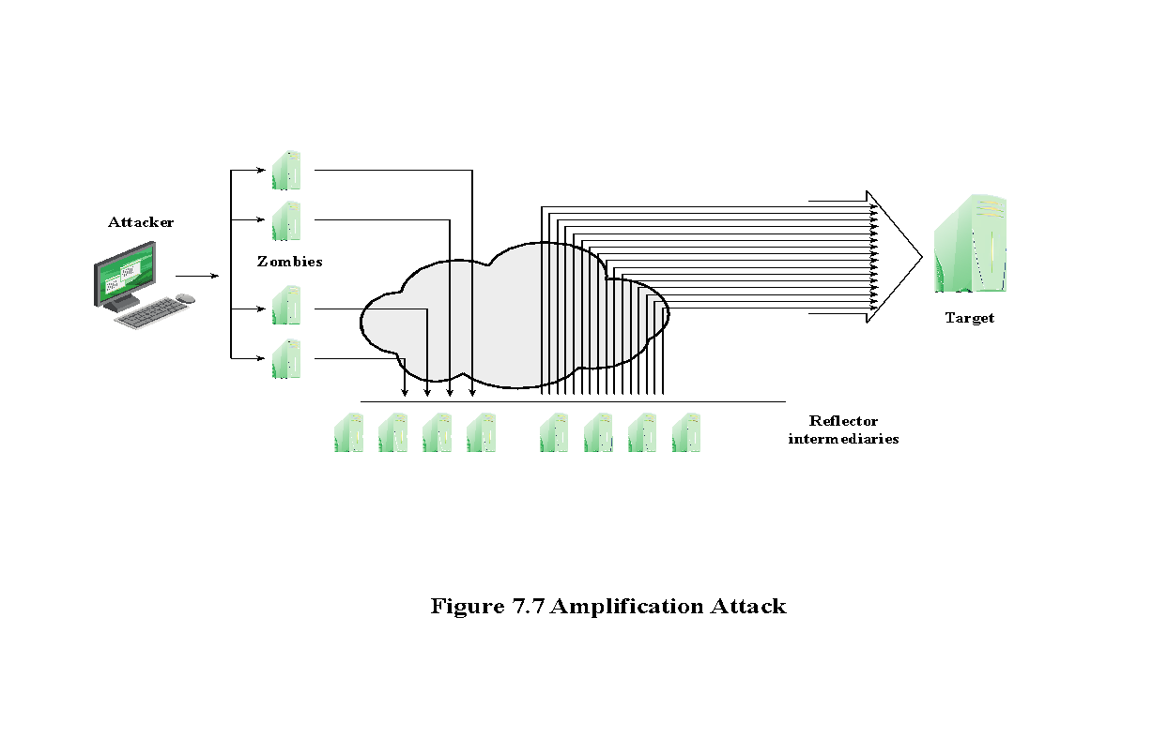
Amplification Attacks
Notes:
17
Amplification attacks are a variant of reflector attacks and also involve sending a
packet with a spoofed source address for the target system to intermediaries. They
differ in generating multiple response packets for each original packet sent. This can
be achieved by directing the original request to the broadcast address for some network.
As a result, all hosts on that network can potentially respond to the request,
generating a flood of responses as shown in Figure 7.7 . It is only necessary to use
a service handled by large numbers of hosts on the intermediate network. A ping
flood using ICMP echo request packets was a common choice, since this service
is a fundamental component of TCP/IP implementations and was often allowed
into networks. The well-known smurf DoS program used this mechanism and was
widely popular for some time. Another possibility is to use a suitable UDP service,
such as the echo service. The fraggle program implemented this variant. Note that
TCP services cannot be used in this type of attack; because they are connection
oriented, they cannot be directed at a broadcast address. Broadcasts are inherently
connectionless.
The best additional defense against this form of attack is to not allow directed
broadcasts to be routed into a network from outside. Indeed, this is another longstanding
security recommendation, unfortunately about as widely implemented as
that for blocking spoofed source addresses. If these forms of filtering are in place,
these attacks cannot succeed. Another defense is to limit network services like echo
and ping from being accessed from outside an organization. This restricts which
services could be used in these attacks, at a cost in ease of analyzing some legitimate
network problems.
Attackers scan the Internet looking for well-connected networks that do allow
directed broadcasts and that implement suitable services attackers can reflect off.
These lists are traded and used to implement such attacks.

Slide 18
Example: Smurf Attack
https://www.youtube.com/watch?v=KLfYKXwgflA
Notes:
18

Slide 19
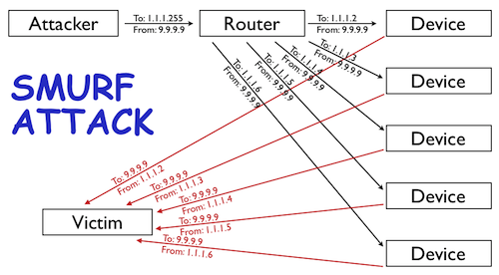
Example: SMURF
Uses ICMP (ping).
1. Hacker identifies a victim IP.
2. Hacker identifies an intermediary site that will amplify the attack
3. Hacker sends a large amount of ICMP (ping, layer 3) traffic at the broadcast address of the intermediary site.
4. Packets have the source IP address spoofed to point towards the victim.
4. Intermediaries deliver the broadcast at layer 2 to all the hosts on their subnet.
5. Hosts reply to the victim network.
Ping can’t be much of problem?
My upload speed is has a 1M
150 intermediary sites = 150Mbps
Ultra Fast Fibre broadband has download speed of 200Mbps
Notes:
19
Uses ICMP (ping).
1. Hacker identifies a victim IP address (your Web server is usually a nice high-profile target).
2. Hacker identifies an intermediary site that will amplify the attack (usually several are selected, to further disguise the attack).
3. Hacker sends a large amount of ICMP (ping, layer 3) traffic at the broadcast address of the intermediary sites. These packets have the source IP address spoofed to point towards the victim.
4. Intermediaries deliver the broadcast at layer 2 to all the hosts on their subnet.
5. Hosts reply to the victim network.

Slide 20
Example: DNS Amplification Attacks
https://www.youtube.com/watch?v=xTKjHWkDwP0
Notes:
20
In addition to the DNS reflection attack discussed previously, a further variant of an
amplification attack uses packets directed at a legitimate DNS server as the intermediary
system. Attackers gain attack amplification by exploiting the behavior of the
DNS protocol to convert a small request into a much larger response. This contrasts
with the original amplifier attacks, which use responses from multiple systems to a
single request to gain amplification. Using the classic DNS protocol, a 60-byte UDP
request packet can easily result in a 512-byte UDP response, the maximum traditionally
allowed. All that is needed is a name server with DNS records large enough for
this to occur.
These attacks have been seen for several years. More recently, the DNS
protocol has been extended to allow much larger responses of over 4000 bytes to
support extended DNS features such as IPv6, security, and others. By targeting
servers that support the extended DNS protocol, significantly greater amplification
can be achieved than with the classic DNS protocol.
In this attack, a selection of suitable DNS servers with good network connections
are chosen. The attacker creates a series of DNS requests containing
the spoofed source address of the target system. These are directed at a number
of the selected name servers. The servers respond to these requests, sending the
replies to the spoofed source, which appears to them to be the legitimate requesting
system. The target is then flooded with their responses. Because of the amplification
achieved, the attacker need only generate a moderate flow of packets to
cause a larger, amplified flow to flood and overflow the link to the target system.
Intermediate systems will also experience significant loads. By using a number of
high-capacity, well-connected systems, the attacker can ensure that intermediate
systems are not overloaded, allowing the attack to proceed.
A further variant of this attack exploits recursive DNS name servers. This is
a basic feature of the DNS protocol that permits a DNS name server to query a
number of other servers to resolve a query for its clients. The intention was that this
feature is used to support local clients only. However, many DNS systems support
recursion by default for any requests. They are known as open recursive DNS servers.
Attackers may exploit such servers for a number of DNS-based attacks, including
the DNS amplification DoS attack. In this variant, the attacker targets a number
of open recursive DNS servers. The name information being used for the attack
need not reside on these servers, but can be sourced from anywhere on the Internet.
The results are directed at the desired target using spoofed source addresses.
Like all the reflection-based attacks, the basic defense against these is to
prevent the use of spoofed source addresses. Appropriate configuration of DNS
servers, in particular limiting recursive responses to internal client systems only, as
described in RFC 5358, can restrict some variants of this attack.

Slide 21
Example: DNS Amplification Attacks
Use packets directed at a legitimate DNS server as the intermediary system (an open resolver)
Attacker creates a series of DNS requests containing the spoofed source address of the target system
Exploit DNS behaviour to convert a small request to a much larger response (amplification)
Target is flooded with responses
QUERY:
dig ANY isc.org @x.x.x.x
ANSWER:
; <<>> DiG 9.7.3 <<>> ANY isc.org @x.x.x.x
;; global options: +cmd
;; Got answer:
;; ->>HEADER<<- opcode: QUERY, status: NOERROR, id: 5147
;; flags: qr rd ra; QUERY: 1, ANSWER: 27, AUTHORITY: 4, ADDITIONAL: 5
;; QUESTION SECTION:
;isc.org. IN ANY
;; ANSWER SECTION:
isc.org. 4084 IN SOA ns-int.isc.org. hostmaster.isc.org. 2012102700 7200 3600 24796800 3600
<SNIP ...>
;; Query time: 176 msec
;;SERVER: x.x.x.x#53(x.x.x.x)
;; WHEN: Tue Oct 30 01:14:32 2012
;; MSG SIZE rcvd: 3223
Notes:
21
In addition to the DNS reflection attack discussed previously, a further variant of an
amplification attack uses packets directed at a legitimate DNS server as the intermediary
system. Attackers gain attack amplification by exploiting the behavior of the
DNS protocol to convert a small request into a much larger response. This contrasts
with the original amplifier attacks, which use responses from multiple systems to a
single request to gain amplification. Using the classic DNS protocol, a 60-byte UDP
request packet can easily result in a 512-byte UDP response, the maximum traditionally
allowed. All that is needed is a name server with DNS records large enough for
this to occur.
These attacks have been seen for several years. More recently, the DNS
protocol has been extended to allow much larger responses of over 4000 bytes to
support extended DNS features such as IPv6, security, and others. By targeting
servers that support the extended DNS protocol, significantly greater amplification
can be achieved than with the classic DNS protocol.
In this attack, a selection of suitable DNS servers with good network connections
are chosen. The attacker creates a series of DNS requests containing
the spoofed source address of the target system. These are directed at a number
of the selected name servers. The servers respond to these requests, sending the
replies to the spoofed source, which appears to them to be the legitimate requesting
system. The target is then flooded with their responses. Because of the amplification
achieved, the attacker need only generate a moderate flow of packets to
cause a larger, amplified flow to flood and overflow the link to the target system.
Intermediate systems will also experience significant loads. By using a number of
high-capacity, well-connected systems, the attacker can ensure that intermediate
systems are not overloaded, allowing the attack to proceed.
A further variant of this attack exploits recursive DNS name servers. This is
a basic feature of the DNS protocol that permits a DNS name server to query a
number of other servers to resolve a query for its clients. The intention was that this
feature is used to support local clients only. However, many DNS systems support
recursion by default for any requests. They are known as open recursive DNS servers.
Attackers may exploit such servers for a number of DNS-based attacks, including
the DNS amplification DoS attack. In this variant, the attacker targets a number
of open recursive DNS servers. The name information being used for the attack
need not reside on these servers, but can be sourced from anywhere on the Internet.
The results are directed at the desired target using spoofed source addresses.
Like all the reflection-based attacks, the basic defense against these is to
prevent the use of spoofed source addresses. Appropriate configuration of DNS
servers, in particular limiting recursive responses to internal client systems only, as
described in RFC 5358, can restrict some variants of this attack.

Slide 22
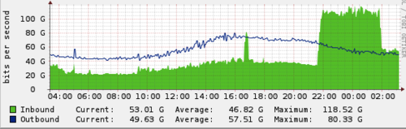
“Spamhaus” Attack
Notes:
https://blog.cloudflare.com/the-ddos-that-knocked-spamhaus-offline-and-ho/
“Spamhaus is directly or indirectly responsible for filtering as much as 80% of daily spam messages.”
The largest source of attack traffic against Spamhaus came from DNS reflection.
In the Spamhaus case, the attacker was sending requests for the DNS zone file for ripe.net to open DNS resolvers.
The attacker spoofed the CloudFlare IPs we'd issued for Spamhaus as the source in their DNS requests. The open resolvers responded with DNS zone file, generating collectively approximately 75Gbps of attack traffic. The requests were likely approximately 36 bytes long (e.g. dig ANY ripe.net @X.X.X.X +edns=0 +bufsize=4096, where X.X.X.X is replaced with the IP address of an open DNS resolver) and the response was approximately 3,000 bytes, translating to a 100x amplification factor.
We recorded over 30,000 unique DNS resolvers involved in the attack. This translates to each open DNS resolver sending an average of 2.5Mbps, which is small enough to fly under the radar of most DNS resolvers. Because the attacker used a DNS amplification, the attacker only needed to control a botnet or cluster of servers to generate 750Mbps -- which is possible with a small sized botnet or a handful of AWS instances.
It is worth repeating: open DNS resolvers are the scourge of the Internet and these attacks will become more common and large until service providers take serious efforts to close them.

Slide 23
Requirements for an Effective Service Amplification Attack
Transport layer protocol must not require handshake.
Size of response >> size of request.
Services must be configured to respond to attacker (or just be accessible to anyone!).
Servers should have high capacity links to Internet.
Notes:
23
In addition to the DNS reflection attack discussed previously, a further variant of an
amplification attack uses packets directed at a legitimate DNS server as the intermediary
system. Attackers gain attack amplification by exploiting the behavior of the
DNS protocol to convert a small request into a much larger response. This contrasts
with the original amplifier attacks, which use responses from multiple systems to a
single request to gain amplification. Using the classic DNS protocol, a 60-byte UDP
request packet can easily result in a 512-byte UDP response, the maximum traditionally
allowed. All that is needed is a name server with DNS records large enough for
this to occur.
These attacks have been seen for several years. More recently, the DNS
protocol has been extended to allow much larger responses of over 4000 bytes to
support extended DNS features such as IPv6, security, and others. By targeting
servers that support the extended DNS protocol, significantly greater amplification
can be achieved than with the classic DNS protocol.
In this attack, a selection of suitable DNS servers with good network connections
are chosen. The attacker creates a series of DNS requests containing
the spoofed source address of the target system. These are directed at a number
of the selected name servers. The servers respond to these requests, sending the
replies to the spoofed source, which appears to them to be the legitimate requesting
system. The target is then flooded with their responses. Because of the amplification
achieved, the attacker need only generate a moderate flow of packets to
cause a larger, amplified flow to flood and overflow the link to the target system.
Intermediate systems will also experience significant loads. By using a number of
high-capacity, well-connected systems, the attacker can ensure that intermediate
systems are not overloaded, allowing the attack to proceed.
A further variant of this attack exploits recursive DNS name servers. This is
a basic feature of the DNS protocol that permits a DNS name server to query a
number of other servers to resolve a query for its clients. The intention was that this
feature is used to support local clients only. However, many DNS systems support
recursion by default for any requests. They are known as open recursive DNS servers.
Attackers may exploit such servers for a number of DNS-based attacks, including
the DNS amplification DoS attack. In this variant, the attacker targets a number
of open recursive DNS servers. The name information being used for the attack
need not reside on these servers, but can be sourced from anywhere on the Internet.
The results are directed at the desired target using spoofed source addresses.
Like all the reflection-based attacks, the basic defense against these is to
prevent the use of spoofed source addresses. Appropriate configuration of DNS
servers, in particular limiting recursive responses to internal client systems only, as
described in RFC 5358, can restrict some variants of this attack.

Slide 24
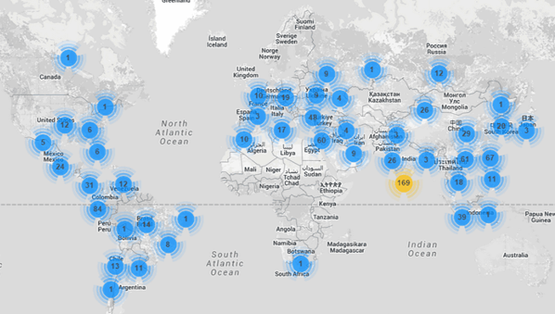
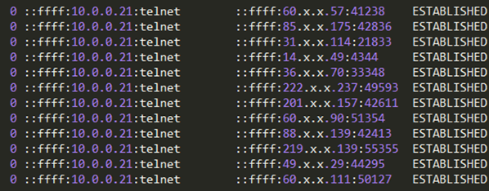
#1 IoT as a new platform
245 million cameras worldwide (2014).
Accessible over the Internet, password protected.
Many of them still have the default or a weak password.
Many run embedded linux (busybox).
Incula blog: CCTV botnet in our own backyard (Oct 2015). https://www.incapsula.com/blog/cctv-ddos-botnet-back-yard.html
HTTP flood attack on client (20,000 requests per second).
Traffic from 900 CCTV cameras distributed across the world.
Cameras had been accessed and worm installed.
Worm scans for telnet/ssh services, brute force attack.
Researchers found one camera was pointing at their office, had to manually go and clean up malware.
Distribution of hacked CCTVs participating in attack
Multiple active sessions by different intruders on a single CCTV camera
Notes:
24

Slide 25
Weaponisation: MIRAI
September 2016: KrebsOnSecurity hit with 665 Gbits/s attack
https://krebsonsecurity.com/2016/09/krebsonsecurity-hit-with-record-ddos/
October 2016: Dyn subject to multipole DDoS taking down populate services 9:30am-4:30pm ET
https://techcrunch.com/2016/10/21/many-sites-including-twitter-and-spotify-suffering-outage/
Attribution (what’s that?) to “Malware Must Die” MIRAI botnet targeting IP cameras and home routers
Scans internet for IoT devices.
Tries 60 common factory default usernames and passwords.
Removes “competing” malware, blocks remote administration ports.
Notes:
25
Attribution is process of making judgement of what and who is behind the attack.

Slide 26
Will it get worse and why?
About 1 billion hosts with registered domain names (2016)
http://www.statista.com/statistics/264473/number-of-internet-hosts-in-the-domain-name-system/
Predictions of 50-100 billion IoT devices by 2020.
http://www.mckinsey.com/industries/high-tech/our-insights/the-internet-of-things-sizing-up-the-opportunity IoT devices have so far been fairly insecure.
- passwords, open remote administration
IoT devices are hard to patch once in the field.
- what if software vulnerabilities detected
IoT sensor networks might be the target of the attack
- Low rate adhoc networks, very vulnerable
Notes:
26

Slide 27
#2 Sophisticated Attacks we have not yet seen
Notes:
27

Slide 28
The Crossfire Attack
Min Suk Kang, Soo Bum Lee, Virgil D. Gligor
ECE Department and CyLab
Carnegie Mellon University
2013 IEEE Symposium on Security and Privacy

Slide 29
INTRODUCTION – Old DDoS
Typical attack:
floods server with HTTP, UDP, SYN, ICMP…… packets
Persistence:
Maximum: 2.5 days
Average: 1.5days
Adversary’s Challenge:
DDoS Attacks are either Persistent or Scalable to N Servers
N traffic to 1 server => high-intensity traffic triggers network detection
Detection not triggered => low-intensity traffic is insufficient for N srevers

Slide 30
INTRODUCTION – Crossfire Attack
Link flooding by botnets cannot be easily countered
Spoofed IP addresses.
Can flood links without using unwanted traffic.
Launch an attack with low-intensity traffic flows that cross a targeted link at roughly the same time and flood it.

Slide 31
INTRODUCTION – Crossfire Attack
A link-flooding attack that degrades/cuts off network connections of scalable N-server area persistently.
Scalable N-Server areas
N = small(e.g., 1-1000 servers), medium(e.g., all servers in a US state), large(e.g., the West Coast of the US)
Persistent:
Attack traffic is indistinguishable from legitimate
Low-rate, changing sets of flows
Attack is “ moving target ” for same N-server area
Changing target links before triggering alarms

Slide 32
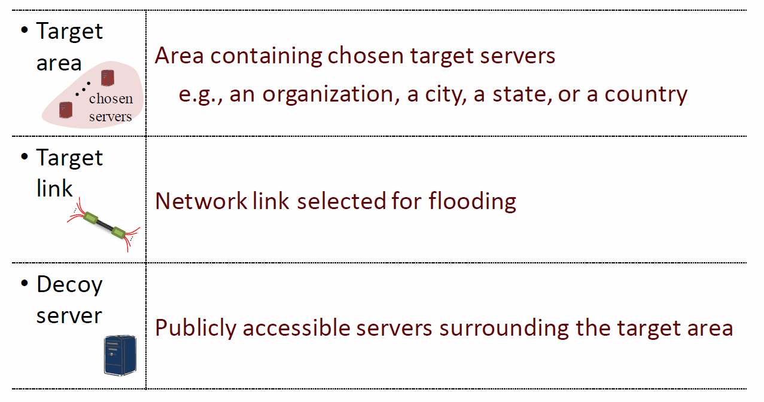
INTRODUCTION – Definitions

Slide 33
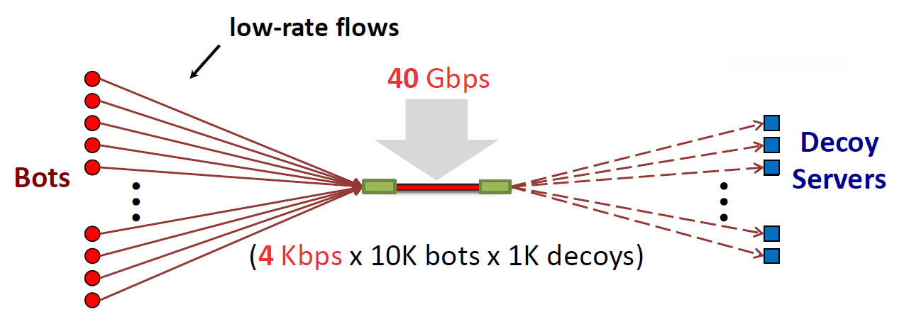
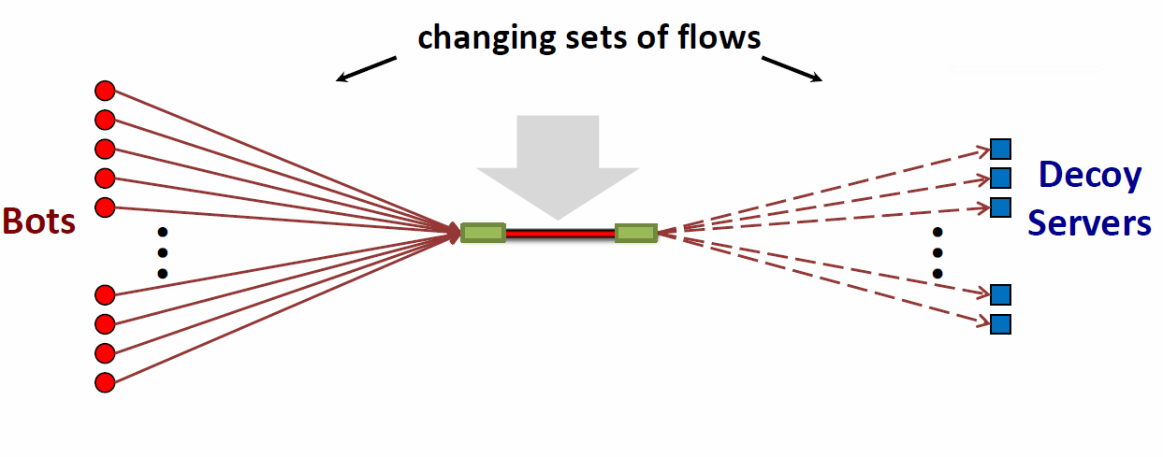
INTRODUCTION – 1 link crossfire
Attack flows => Indistinguishable from legitimate

Slide 34
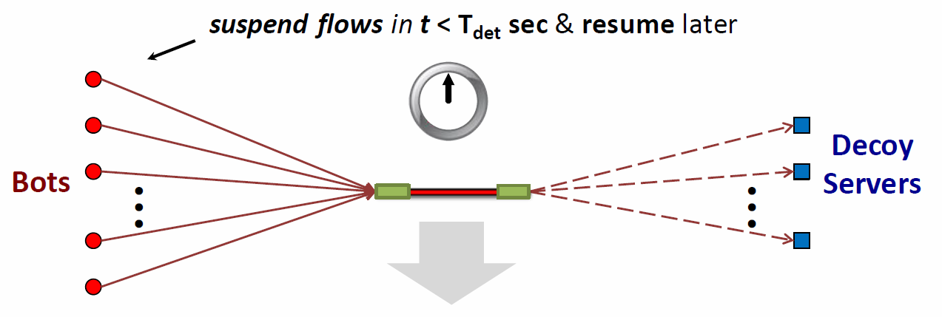
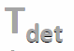
INTRODUCTION – 1 link crossfire
Attack flows => Alarms not triggered
link-failure detection latency,
Interior Gateway Protocol(IGP) routers (OSPF)
Default waiting time: 40sec, Failure detection: 217 sec
Exterior Gateway Protocol(EGP) routers(BGP)
Default waiting time: 180sec, Failure detection : 1,076 sec

Slide 35
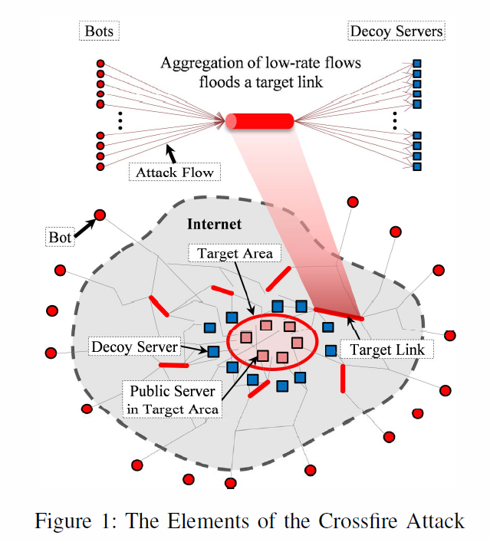
THE CROSSFIRE ATTACK

Slide 36
THE CROSSFIRE ATTACK
Public servers :
To construct an attack topology centered at target area
Decoy servers:
To create attack flow

Slide 37
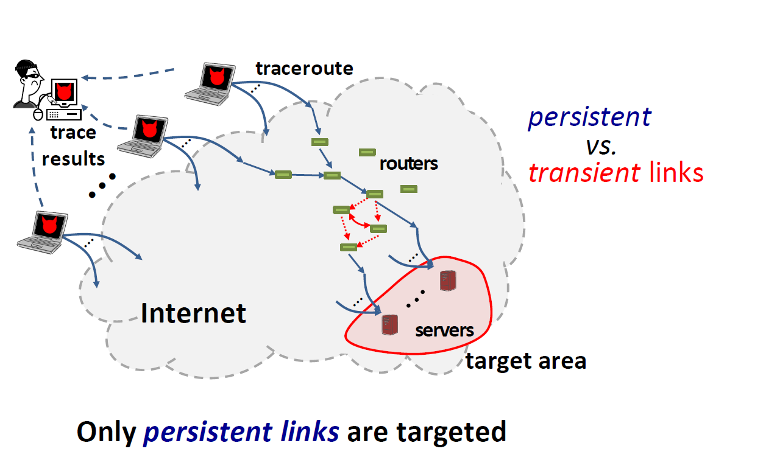
ATTACK - Step 1 : Link Map Construction
( 72% )
(1) Traceroute ( B->S )
(2) Link-Persistence

Slide 38
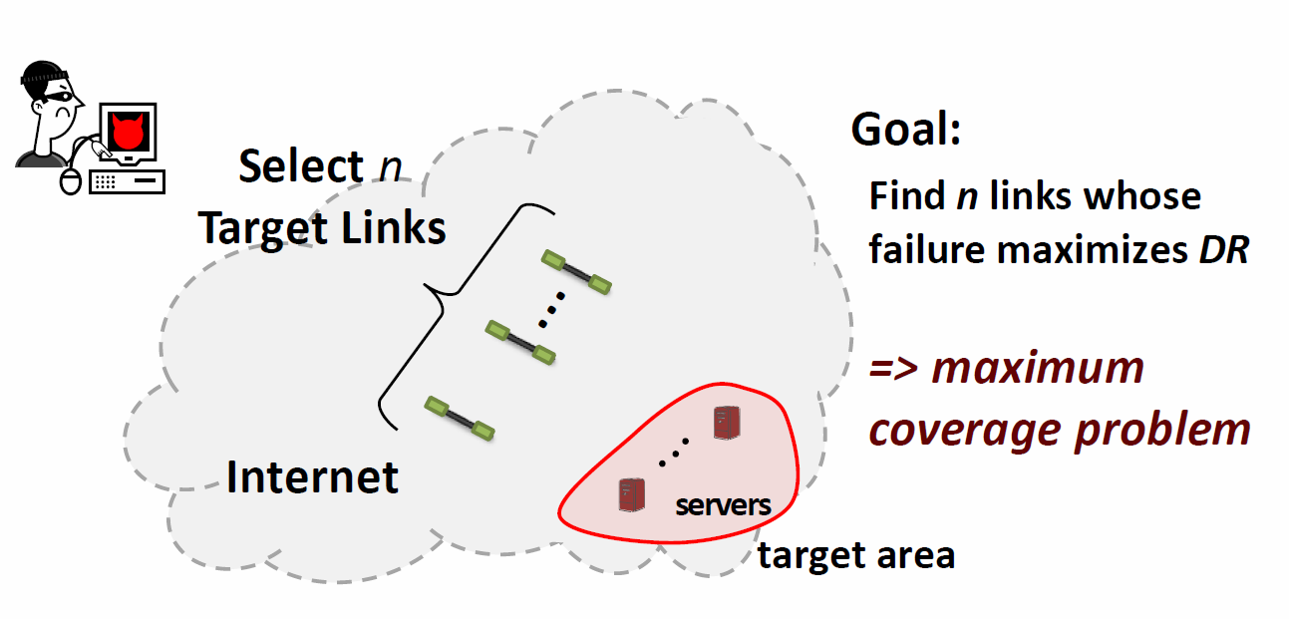
ATTACK - Step 2 : Attack setup
DR: Degradation Ratio
(1) Flow-Density Computation
(2) Target-Link Selection

Slide 39
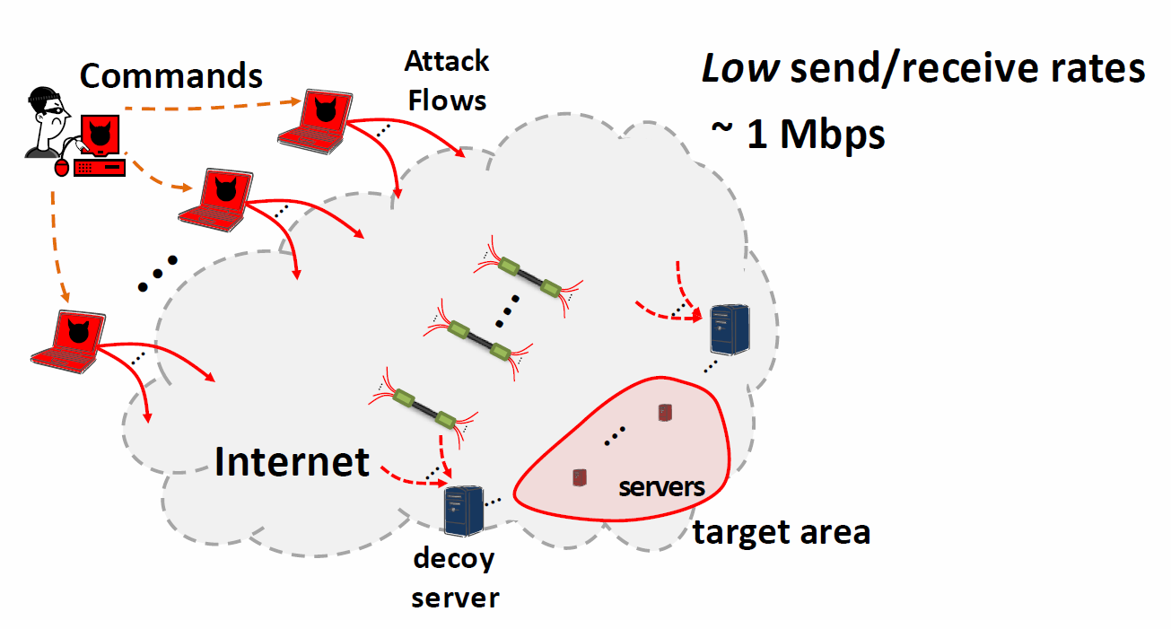
ATTACK - Step 3 : Bot Coordination
(1) Attack-Flow Assignment
(2) Target-Link Flooding

Slide 40
Summary
Denial-of-service attacks
The nature of denial-of-service attacks
Classic denial-of-service attacks
Source address spoofing
SYN spoofing
Flooding attacks
ICMP flood
UDP flood
TCP SYN flood
Distributed denial-of-service attacks
Application-based bandwidth attacks
HTTP-based attacks
Reflector and amplifier attacks
Reflection attacks
Amplification attacks
DNS amplification attacks
Internet of Things and DDoS
Crossfire Attack
Notes:
40
Chapter 7 summary.

